Slide 1
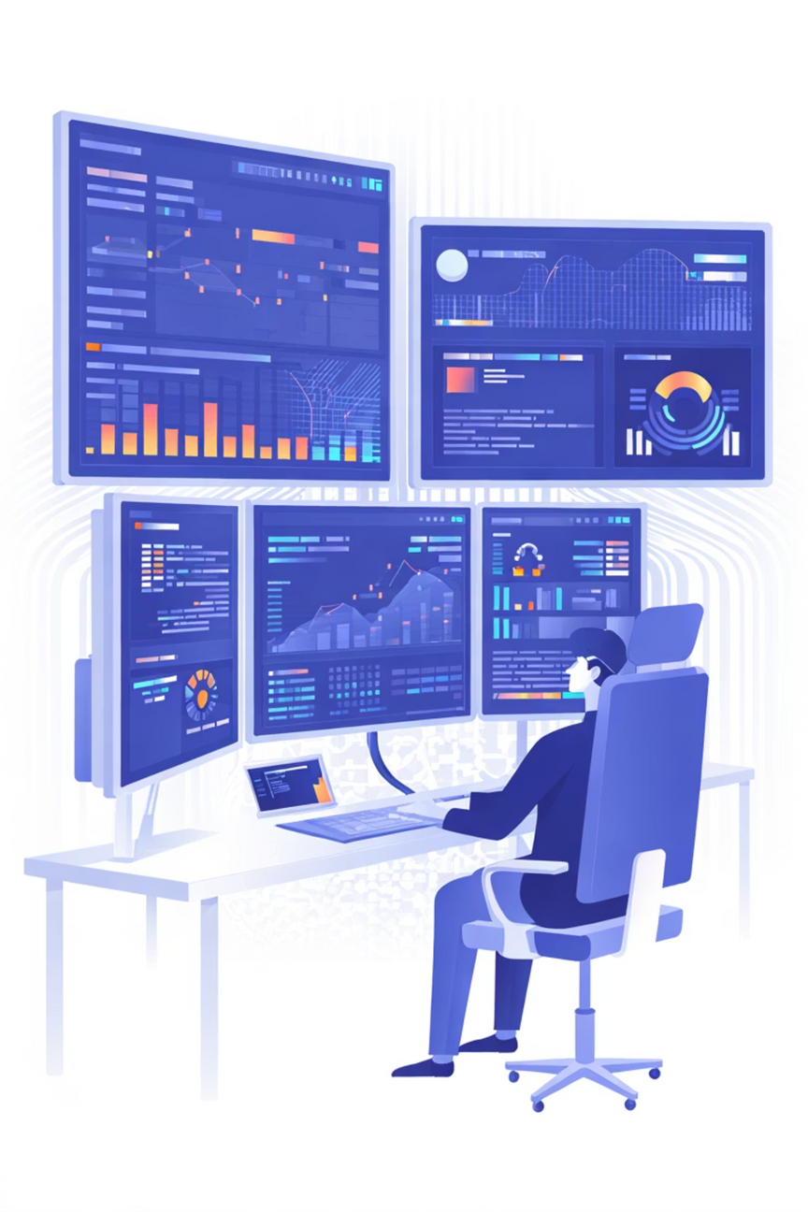
OSINT Threat Intelligence Dashboard
A unified platform for gathering, visualizing, and exporting open-source intelligence data from multiple OSINT tools and data sources.
HIMANSHU GIDWANI (E23CSEU2258)
KANISHK RAI (E23CSEU2178)
DHRUV GUPTA (E23CSEU2249)
RACHELL GUPTA (E23CSEU2187)
ABHISHEK KUMAR (E23CSEU2239)
PRANJAL TANWAR (E23CSEU2318)
Notes:
1

Slide 2
The Intelligence Challenge
Modern cybersecurity operations demand rapid threat intelligence collection, but analysts struggle with fragmented tools, manual processes, and disparate data sources. A centralized solution is critical.
Fragmented Data
Manual Workflows
Missing Visualization
Intelligence scattered across Shodan, Google Dorks, theHarvester, and countless APIs with no single source of truth.
Time-consuming data collection and entry errors create inefficiencies and miss critical threat signals in real-time.
Lack of centralized dashboard prevents analysts from quickly correlating findings and identifying patterns across datasets.
Notes:
2

Slide 3
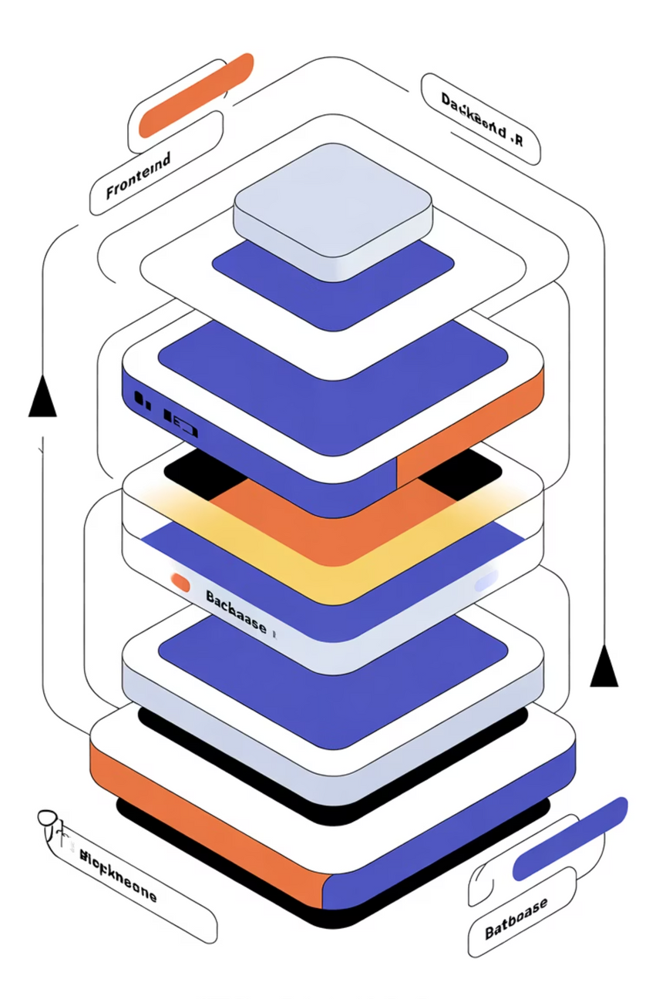
Solution Architecture
A full-stack web application integrating frontend visualization, Python backend processing, and persistent storage for seamless OSINT workflows.
Frontend
Bootstrap UI + DataTables
Backend
Flask Routes + Logic
Database
SQLite Storage
Visualization
Folium Maps
Notes:
3

Slide 4




Core Components
Technical Foundation
SQLite Schema
Folium Mapping
Lightweight relational storage with findings table: id, type, value, source, latitude, longitude for geographic correlation.
Interactive geolocation visualization rendering IP coordinates as clickable markers on real-world maps with heatmap overlays.
PDF Export
Flask API
pdfkit and wkhtmltopdf convert dashboard findings into professional PDF reports for stakeholder distribution and compliance.
RESTful endpoints (/collect, /findings, /heatmap, /export) handle AJAX requests and coordinate data flow between all layers.
Notes:
4

Slide 5
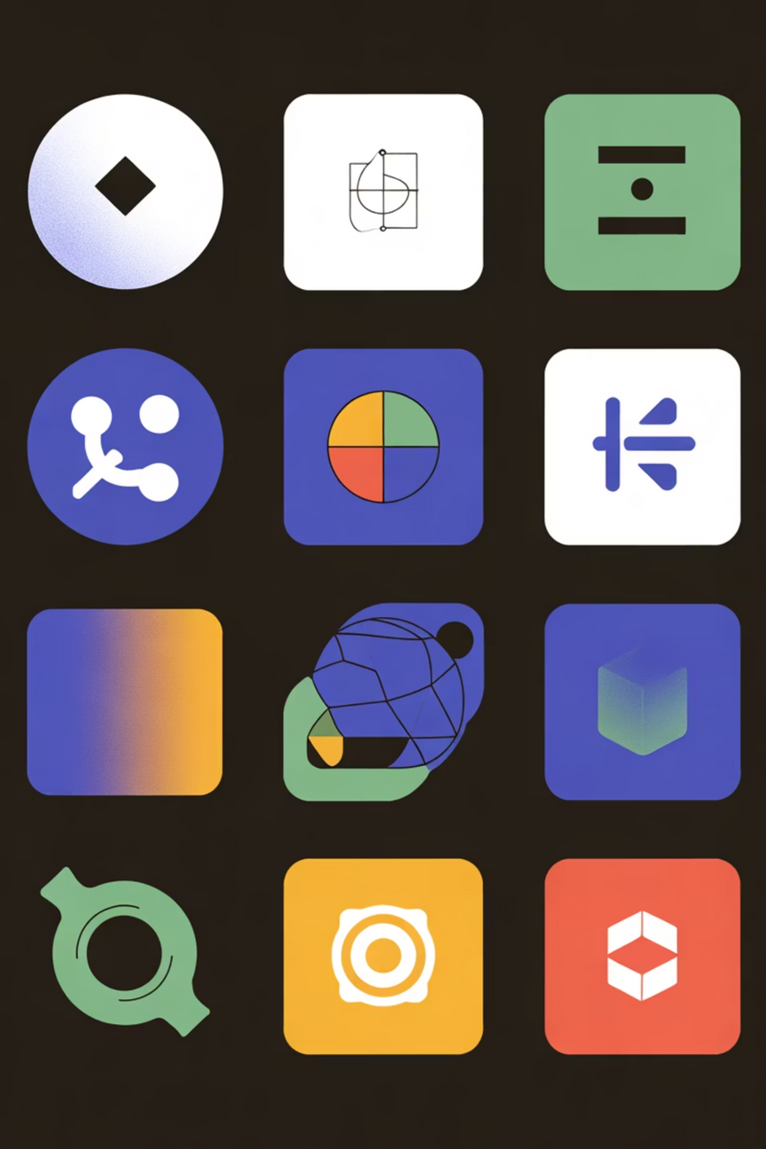

Intelligence Gathering
Simulated OSINT Modules
The dashboard currently integrates simulated data from major OSINT platforms, with architecture designed for live API integration.
01
02
Shodan Simulation
theHarvester Simulation
Generates sample IP addresses and device metadata for vulnerability assessment and network reconnaissance.
Produces harvested email addresses and subdomains for passive reconnaissance and organizational footprint mapping.
03
04
Google Dorks Simulation
Maltego Simulation
Simulates advanced search results revealing exposed domains, configuration files, and sensitive data through search engine queries.
Functions as a link analysis and data mining tool for investigating relationships between entities and visualizing complex networks.
Notes:
5

Slide 6
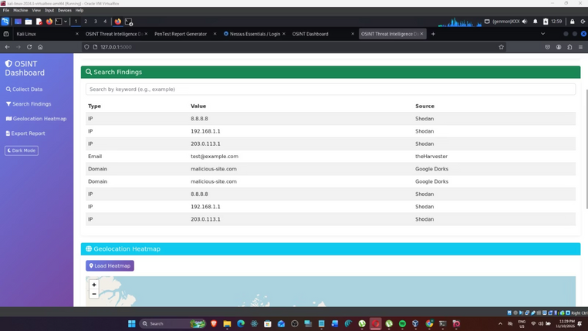
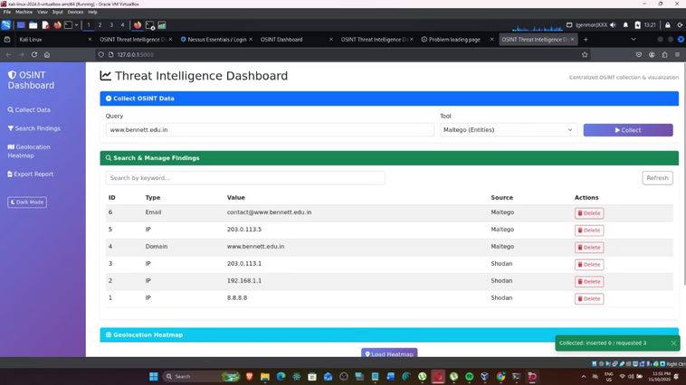
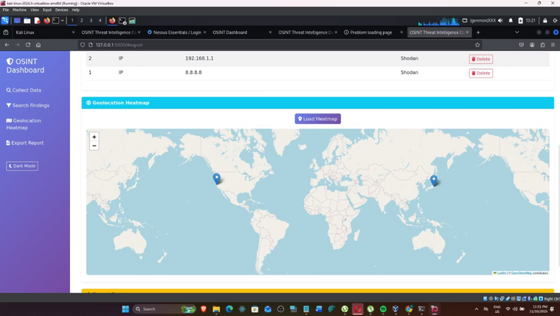
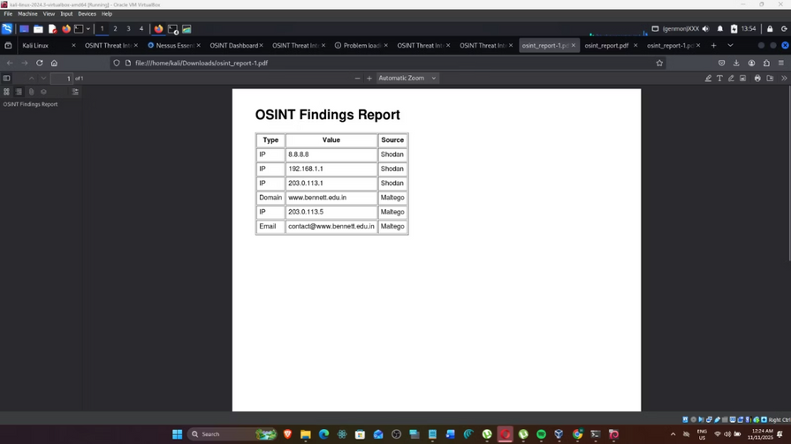
Operational Results
Notes:
6

Slide 7

Unique Value Proposition
Our dashboard introduces a novel approach to OSINT investigations by seamlessly integrating four powerful tools: Shodan, theHarvester, Google Dorks, and Maltego. Unlike other solutions available in the market that often require analysts to juggle multiple applications and disparate data sources, our platform provides a single, unified environment for comprehensive intelligence gathering.
This integrated approach ensures that data from various sources is correlated and presented in a cohesive manner, offering a holistic view of the target. The centralized visualization capabilities allow users to analyze complex relationships and patterns that might otherwise be missed when using fragmented tools. Furthermore, the seamless workflow significantly enhances efficiency, eliminating the need to constantly switch between different interfaces, reducing cognitive load, and accelerating the investigation process from data collection to insightful analysis.
Notes:
7

Slide 8

Strategic Roadmap
Future Development Priorities
Transforming this prototype into a production-grade threat intelligence platform requires systematic enhancement across integration, analytics, security, and automation layers.
Live API Integration
Connect to Shodan, Censys, VirusTotal, Hunter.io, and emerging threat feeds for real-time intelligence.
Enhanced Analytics
Implement correlation engines, frequency analysis, relationship graphs, and visual link analysis for pattern detection.
Threat Scoring System
Develop severity ranking algorithms for IPs, domains, and emails with contextual risk assessment and prioritization.
User Accounts & Auth
Add Flask-Login authentication, role-based access control, user workspaces, and saved investigation histories.
Automation & Scheduling
Background job processing with cron scheduling, recurring searches, alert triggers, and automated report generation.
Advanced Visualization
Map clustering, heat density analysis, layer toggling, temporal heatmaps, and custom data visualization options.
Notes:
8

Slide 9

Path to Production
This OSINT Threat Intelligence Dashboard provides a solid foundation for enterprise threat intelligence operations. The modular architecture enables iterative enhancement while maintaining stability. Focus initial production deployment on API integration, authentication, and advanced analytics to maximize operational impact.
Immediate Priority: Live API integration for real-time threat data at scale.
Secondary Priority: Authentication and multi-user support for team collaboration.
Strategic Focus: Threat scoring and automated alerting for operational efficiency.
Notes:
9

Slide 10
Thank You
Notes:
10

